Slide 1
WSPR
George Smart, M1GEO.
Notes:
Introduce myself
Note previous WSPR Talk (before I started club)
Dave, M0TAZ, asked me to talk about what I’d been doing with WSPR

Slide 2
Introduction
WSPR: Weak Signal Propagation Reporter
Probes propagation paths with QRP transmissions
Typically under 5 watts.
DSP allows for reception of very weak signals
-28 dB in 2.5 KHz filter
Real time path mapping via Internet
http://www.wsprnet.org/
Notes:
WEAK SIG PROP REPORTER: PART OF WSJT. JT65 etc
Joe Taylor. K1JT. Nobel Price in Physics. New type of PULSAR (star).
All about QRP. Low power. Weak signals!
Low power with narrow bandwidth gives high PSD
DSP allows very narrow filters to recover signals well below noise floor.

Slide 3
Why WSPR
Narrow Bandwidth (under 6Hz)
Large distances achievable with low transmitter power (less than 5W)
Automatic System
Data collected centrally online with no need of human intervention
Instant Feedback
‘Spots’ visible from distant stations quickly in a range of formats: maps and lists
Signal Coverage At A Glance
Interface overlays stations, paths, and signal reports onto Google Maps
Band openings & Antenna comparisons
Which bands are open to a given location?
Which antenna is better on a given frequency or in a given direction?
Notes:
Narrow BW. More later.
Automatic.
Instant feedback. Maps, database.
Compare antennas and bands

Slide 4
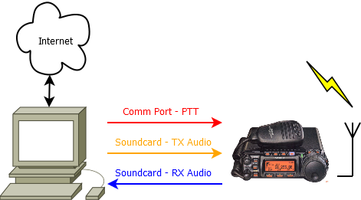
Station Overview
Notes:
Computer at Heart
Generates tones based on Call, Power, Locator
Soundcard makes tones, rig Txes them.
Received tones from Rig to PC soundcard.
DSP narrow filters recover signals

Slide 5
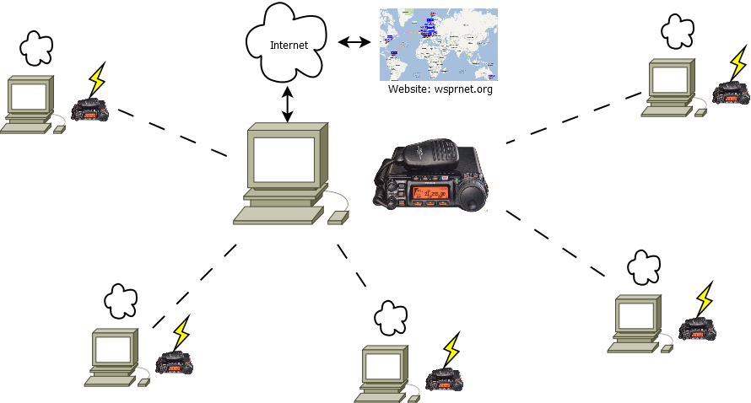
Network Overview
Notes:
When we TX, everyone who hears us, uploads report to database on internet.
When we RX, we upload reports for everyone we hear (can be many stations at a time)
Possible to just do one half, TX or RX.
Website will show maps of collected information

Slide 6
Technical Overview
Set frequencies on each band: HF to SHF
Transmits 50 data bits
Callsign: 28 bits
Maidenhead (QRA) Locator: 15 bits
Output Power in dBm: 7 bits
Forward Error Correction (FEC) aids reception
32 bit convolution code length with 0.5 rate – 162 bits in total to TX.
Data encoded using 4 tones
Tones last 0.66 seconds – tone separation of 1.4 Hz – 5.86 Hz total bandwidth
110.6 seconds total frame length to send 162 bits.
Notes:
Frequencies on next slide
What’s sent
FEC – Reduce errors in lossy system. Redundancy adding extra information to aid reception.
Useful for QSB, Interfearance and spatter. Italians!

Slide 7
Radio Settings
Radio always in Upper Side Band (USB)
Dial Frequencies, in MHz, for each amateur band
Turn off Notch Filters
2200 m | 0.1360 | 17 m | 18.1046
600 m | 0.5024 | 15 m | 21.0946
160 m | 1.8366 | 12 m | 24.9246
80 m | 3.5926 | 10 m | 28.1246
60 m | 5.2872 | 6 m | 50.2930
40 m | 7.0386 | 4 m | 70.0910
30 m | 10.1387 | 2 m | 144.4890
20 m | 14.0956

Slide 8
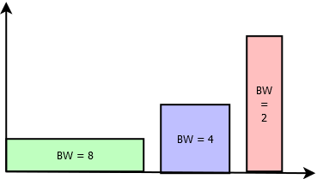
Why Bandwidth Matters
Concentrate power into narrow bandwidth
Like squeezing the end of a hose pipe
We want maximum Power Spectral Density (W/Hz)
Bandwidth of typical amateur radio modes
WSPR: 6 Hz
PSK31: 31 Hz
CW: 150 Hz
RTTY: 250 Hz
SSB: 2400 Hz
FM: 2500-5000 Hz
PSD
Bandwidth
Notes:
Keep on about BW.
Squeeze as much out of our power as possible. Increases RX SNR.
Like squeezing hose pipe end, smaller hole (bw) but greater distance (PSD)
Dxers do this. Toppy audio. No information in Bass. All mid-top.
PSD: Diagram. Area is our power. We can spread how we like.
Gain Bandwidth Product?

Slide 9
WSPR PC Software
Notes:
Whole band 200 Hz wide. ¼ of CW signal.
Each line is 2 minutes (120s) long. 110 to TX, 10 to DSP.
List shows Time, Call, Locator, SNR, Drift.

Slide 10
WSPR Spot Map

Slide 11
WSPR Spot Map #2

Slide 12
WSPR Spot List

Slide 13
What Can We Learn?
Times of day when bands are open
How transmitter power changes the distance
Distance achievable on specific bands
Comparison of antenna effectiveness
Notes:
My interest is looking at things, taking things apart, I like to learn.
When/What band/Antennas are best to work DX?
Power? Does it really help? Double power (3dB) is ½ S point!!!
Get to know what antennas work well on what bands.

Slide 14
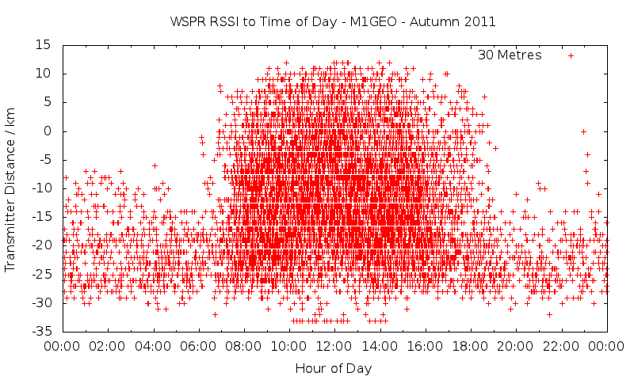
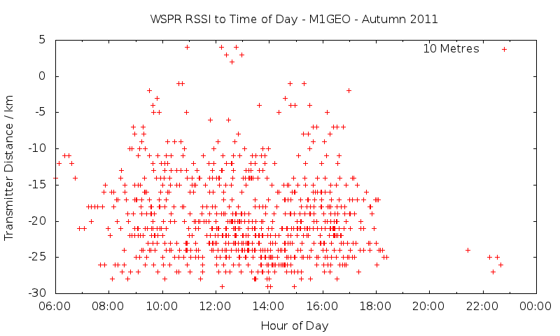
Analysis: Band Openings
Signal Strength / dB
Signal Strengths at Time of Day
30 metres, Autumn 2011
Signal Strengths at Time of Day
10 metres, Autumn 2011
500mW TX power // LDG Z11Pro2 auto-ATU // G5RV
Notes:
These show a lot of information
30m, is like 40m. Works all the time, but what you get changes
Low signals all the time are DX, they’re the occasional USA, AUZ. Weak signals.
Bulk in the day is inter-G. Strong signals, but only when band is open (daylight times).
10m is pretty flat in this graph. Okay during daylight. Nothing at all of a night. Signals nowhere near as strong as 30m.
Linear power factor difference of 10W on 30m to 80W on 10m

Slide 15
Analysis: Transmit Power
20w
5w
10w
3w
2w
1w
½w
Notes:
Cumulative distance. Odd idea to understand.
Addition of every distance you achieve up until a given power.
Minimal difference after 5W.
Really smoother around 5W, more curved into line. Due to the options in software.

Slide 16
Analysis: Band Distances
Australia
Americas
Europe
Notes:
Stock chart. Shows highs, lows and averages.
SKEWED: People on band. Radiation efficiently of my antenna. G5RV. Tuned.
Skeds for VHF, UHF work.

Slide 17
Band Opening Times

Slide 18
Band Opening Times

Slide 19
Custom Transmitter
GPS Receiver provides accurate time and frequency
Digital synthesizer (AD9851 DDS) makes RF drive
Power amplifier makes power output to around ½w
Coax switch selects antenna to transmit on
Notes:
Next idea, switching between antennas in real time needed a custom TX built.
Needs a stable frequency. GPS Locked. Thermally stabilized.
DSP RX will not decode signals that drift more than the BW of the signal (6Hz). Bad practise anywho!
Still work in progress.
Please don’t laugh at the pictures!

Slide 20
At Home

Slide 21
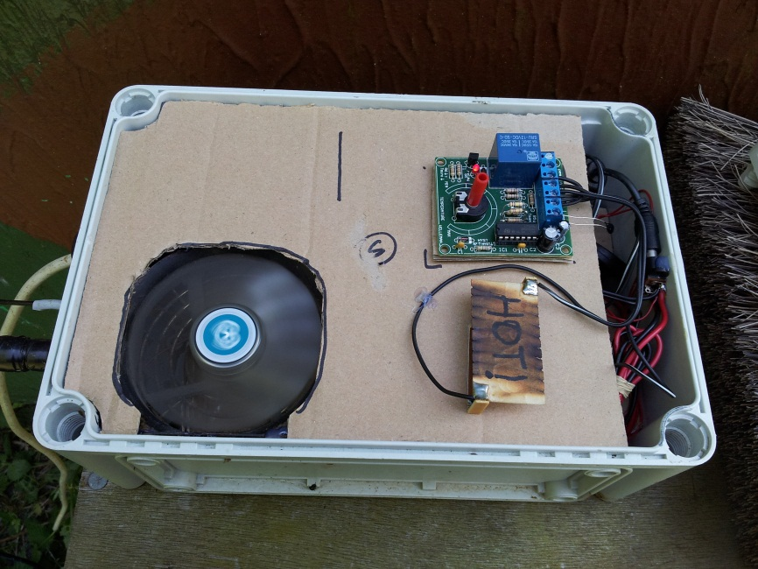
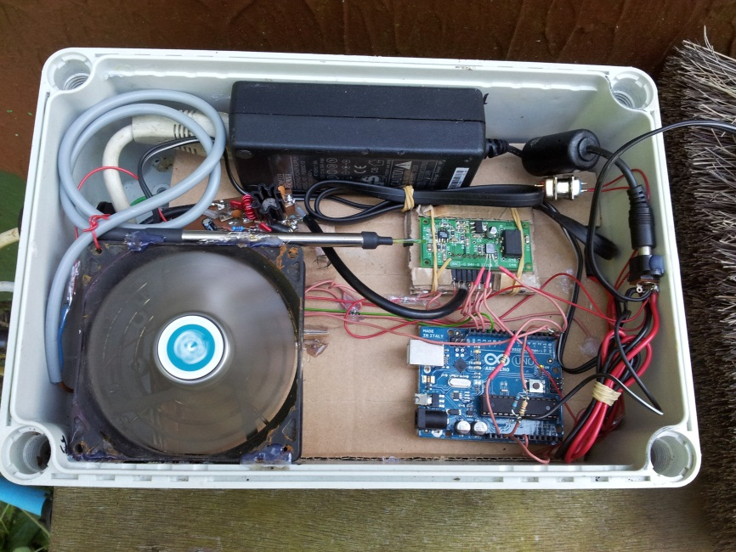
Bunker (GB0SNB)
Top Layer:
Heater
Thermostat
Fan
Middle Layer:
Power Supply
Processor Board
Synthesizer
Power Amplifier

Slide 22
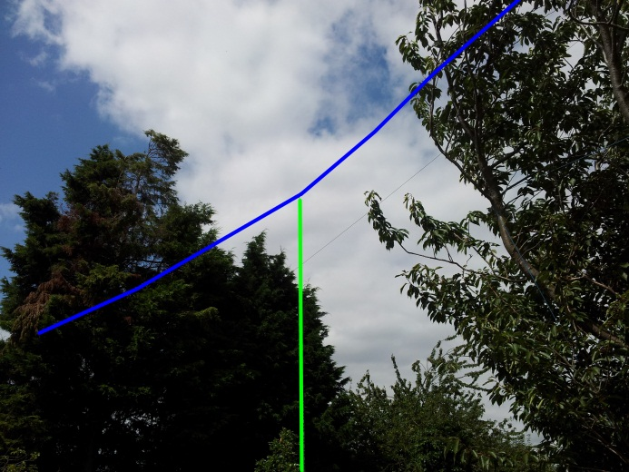
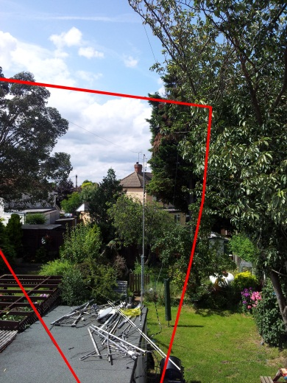
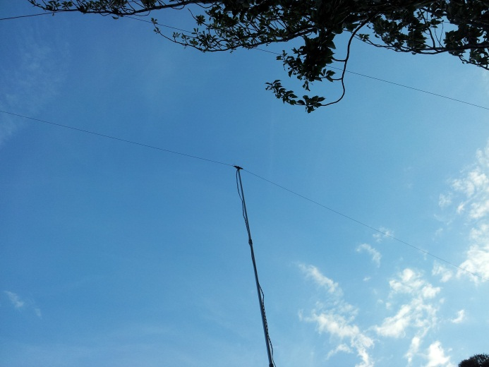
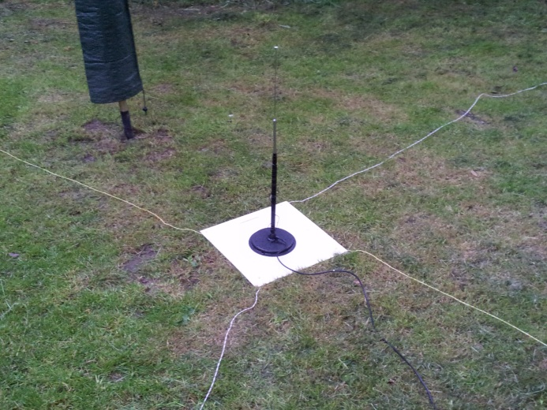
Analysis: Antennas
Notes:
So far, all results have been from the G5RV. Blue/Green
GB0SNB uses the Hustler (vertical)
2.1 Dave’s whip
2.2 30m Dipole (bottom left)
2.3 Hustler

Slide 23
Analysis: Antennas #2.1
Watson MULTI-RANGER-9 (mobile loaded whip) with radials on 30m

Slide 24
Analysis: Antennas #2.2
30 metre resonant dipole fed with 300Ω slotted ladder line and 4:1 balun

Slide 25
Analysis: Antennas #2.3
Hustler 4-BTV 40-10m Vertical on 30m

Slide 26
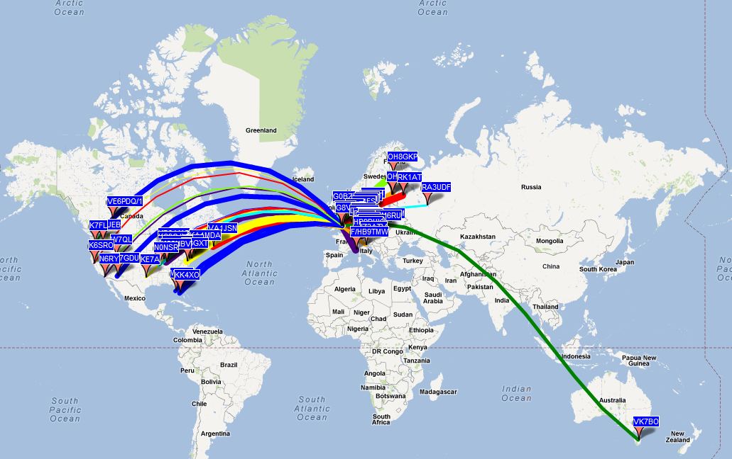
Different Radios: SDR
Notes:
Dave, M0TAZ leant me his Flex 3000. Very nice results on 20 metres. One of the best Rxers I’ve seen/used. This proves it!

Slide 27
Thank You
George Smart, M1GEO.
http://www.george-smart.co.uk/
Notes:
Questions?
Happy to discuss any further things?
Go Back?

Slide 28
Useful Links
WSPR Spot Network (Maps, etc)
http://wsprnet.org/
WSPR Download
http://physics.princeton.edu/pulsar/K1JT/wspr.html
My Website
http://george-smart.co.uk/wiki/WSPR (my maps)
http://george-smart.co.uk/wiki/WSPR_Statistics (analysis stuff)
http://george-smart.co.uk/wiki/Arduino_WSPR (my transmitter design)
Other WSPR related pages on mysite: http://www.george-smart.co.uk

